Slide 1


Slide 2
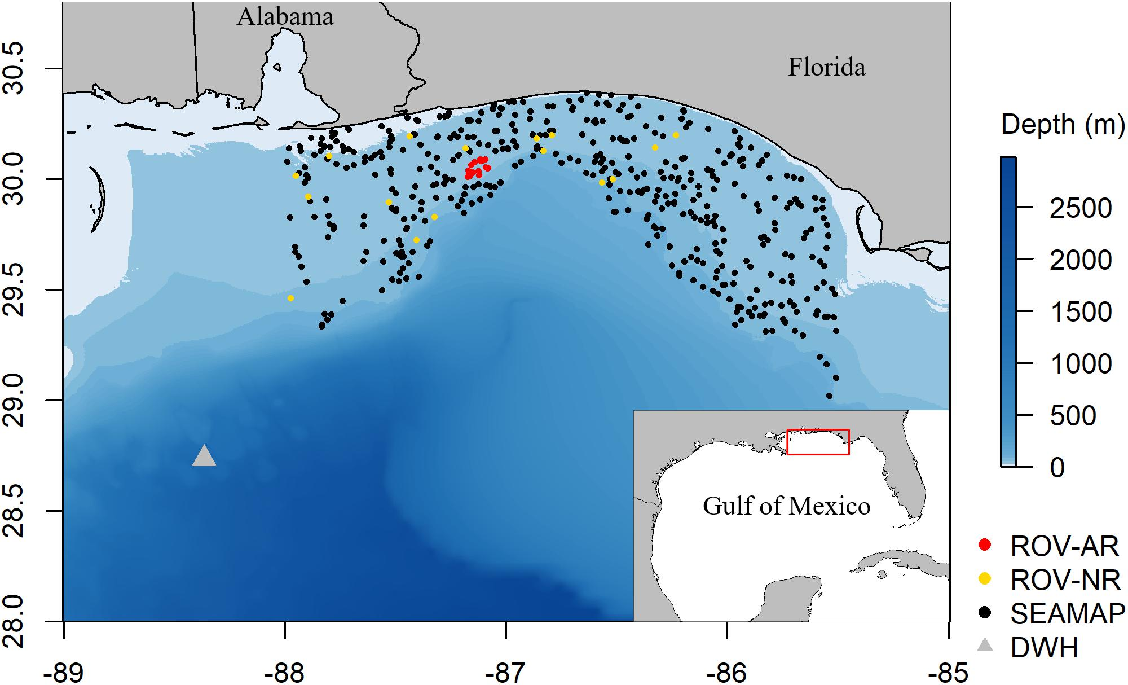
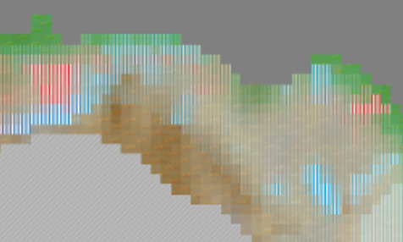
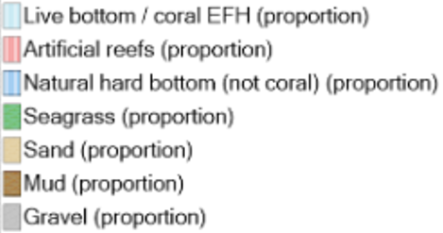
nGoM Artificial Reef Model
Mobile Bay (-88.0) to Choctawhatchee Bay (-85.5).
Reef fish focused model

Slide 3
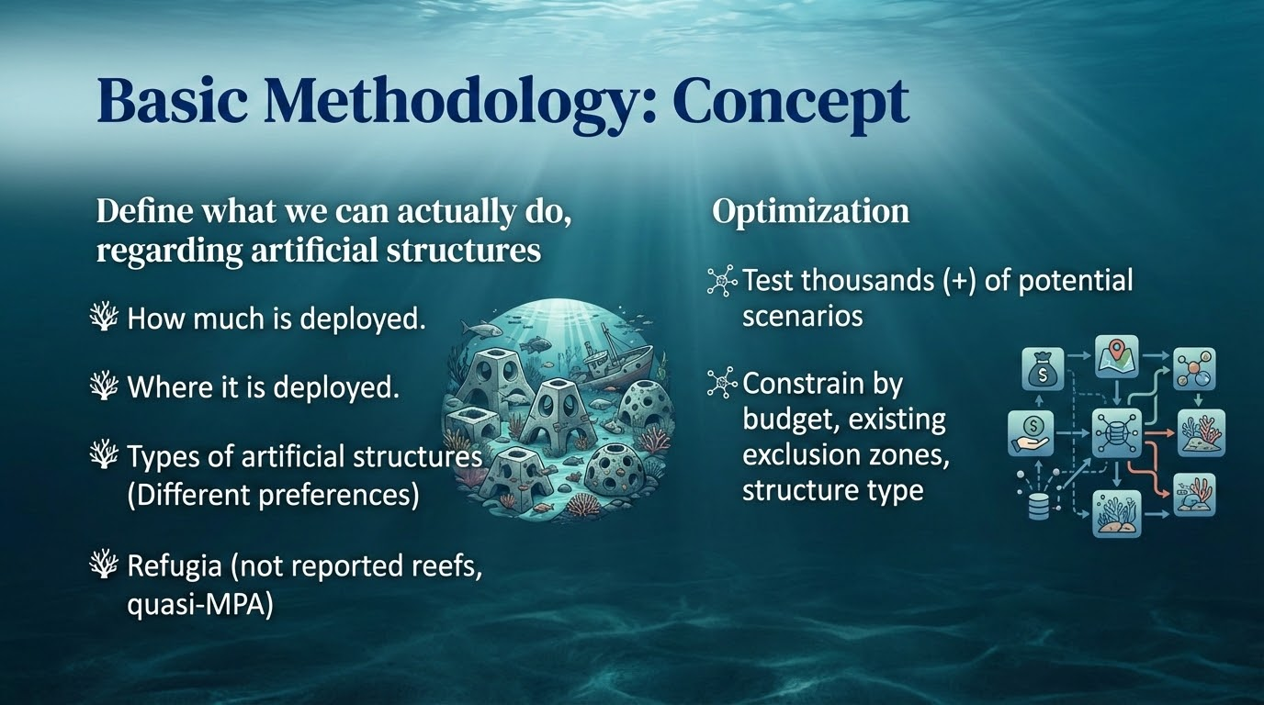

Slide 4
